Slide 1
S&P STOCK GROWTH PREDICTORS
PROJECT 4- GROUP WEDONE
TEAM MEMBERS: Chris Wiggs, Shannon Carroll, Trevor Lochan, Khadija Collymore, Samantha Panzini-Taysi

Slide 2




01
Team mugshot

Slide 3
Table of Contents
Company Overview
Our Customer
Datasource overview
Data fetching + storing (S3 bucket) + Retrieving
ETL - workflow - Data cleaning
Data analysis - visualizations
Building the ML models and optimizations
Testing - accuracy (75% accuracy target)
Conclusions

Slide 4
Company overview
Investing in your financial education is the first step toward achieving your goals. Whether you’re looking to build wealth, save for the future, or simply gain a better understanding of the financial markets, WeDone is here to guide you every step of the way.

Slide 5
Impact
max growth

Slide 6

Our customer
Unlock Your Financial Future with WeDone
Are you ready to take control of your financial destiny? We believe that financial literacy is the key to successful investing. Our mission is to empower young investors with the knowledge and tools they need to navigate the complex world of finance with confidence.
Why Choose WeDone?
Comprehensive Education: We seek to demystify the market, offering in-depth insights to market forces such as Price-to-Earnings (P/E) ratio, volatility, EBITDA, and more.
Proven Stock Price Predictor: Our cutting-edge stock price predictor sets us apart from the competition. Our best model has ~75% accuracy, our predictive model helps you make informed investment decisions. Leveraging advanced algorithms and historical data, our tool provides valuable insights into market trends and potential investment opportunities.

Slide 7
Datasource(s), ETL

Slide 8
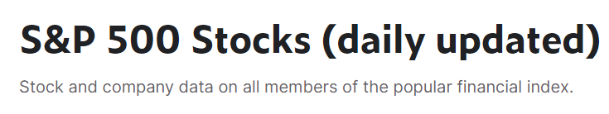
Datasource overview
Sector
Industry
Price
Market Cap
Ebitda
Revenue Growth
Volume
Prices: Open, Close, High, Low

Slide 9

ETL workflow - Data storage and sharing
2010-2013 recession years
Had to choose a three year time span to export the data with sqlalchemy and python
Merged Company dataset with Stock dataset with SQL Alchemy
AWS S3 Object Storage to make the large dataset shareable

Slide 10
User Research questions
Is the stock growing above, at, or below the average rate of growth for its industry? (Over 10 years) - owner: Trevor
Time series analysis - owner: Chris W
How much can revenue growth predict stock price growth; stability/volatility of revenue growth to stock price owner: Shannon?
Price to Earning ratio per industry - Samantha
Finding outliers that don’t follow the P/E standard - owner: Khadija
How does options trading affect the volatility/performance of the stock? - owner: Khadija

Slide 11
Market forces

Slide 12
OUTLIERS
The two rules of identifying outliers are:
- Standard deviation rule: a random variable, sample, statistical population, data set or probability distribution is the square root of its variance
- IQR rule: a measure of statistical dispersion, which is spread of the data
The two outliers that do not follow the P/E standard are SQL and PANDAS-PYTHON. SQL mostly follows ANSI/ ISO standard, this standard is most compliant with the support of major commands as select, update, delete in the same manner.
Potential users can gain information of whether to determine profitable stock:
Chart patterns/multiple approaches Identifying (short-term anomalies)
Determining popularity/ high historical choices(large volumes of market data)
Disarming biases(determining which direction provides the best outcome)

Slide 13
STOCK TRADING AFFECTS
The options trading affect the volatility/performance of the stock in many ways such as implied volatility, trading strategies, option premiums, stock price swings and or stock standard deviation. In all, effects of stocks does stocks not ruin the purchase but it can create multiple narratives of why the stock is not being purchased.
The effects of volatility/performance:
Create dispersion of security
Change of inflation trends(creating a sense of doubt in potential investors)
Making extreme moves of direction, which intern sets market manic
Domino effects of economic prices increasing to maintain a growth assets for high-yield of treasury

Slide 14
PRICE TO EARNINGS RATIO
P/E Ratio (Price to Earnings Ratio): The P/E ratio is a measure of a company's current share price relative to its earnings per share (EPS). A higher P/E ratio generally suggests that investors are willing to pay more for the company's earnings, often indicating optimism about future growth prospects.
Methodology for Calculating P/E Ratio
Calculated as the current share price divided by the earnings per share (EPS)
Median P/E Ratio
Computed the median P/E ratio unlike the mean (average), which can be influenced by extreme values. The median P/E ratio gives us a more robust measure of the typical valuation within the industry.

Slide 15
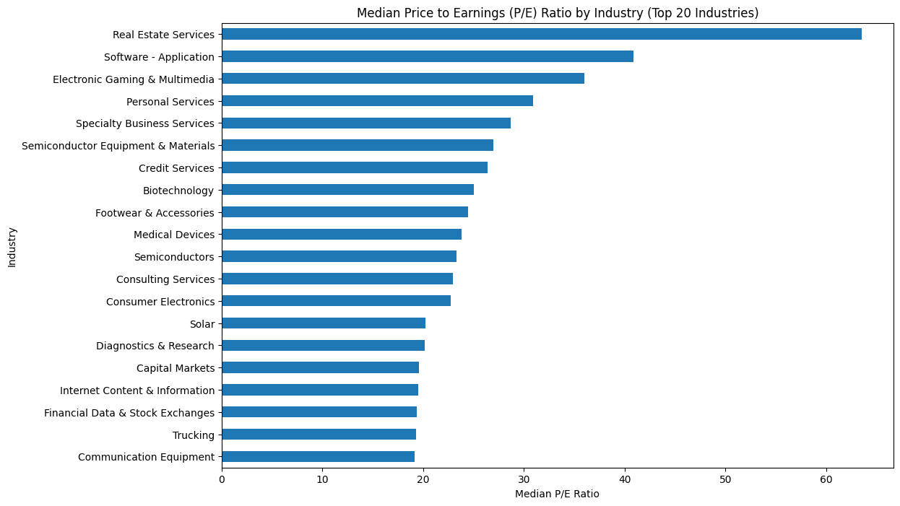
MEDIAN PRICE TO EARNINGS RATIO BY INDUSTRY TOP 20

Slide 16
PRICE TO EARNINGS RATIO
Visualization
Created a bar graph to display the median P/E ratios for the top 20 industries. The graph displays the median P/E ratios for the top 20 industries. A higher P/E ratio suggests higher growth expectations and potentially higher valuations.
Recommendations based on findings
Diversify Investments: Consider spreading investments across industries with high P/E ratios to mitigate risks.
Growth Potential: Focus on industries with higher median P/E ratios for potential high growth returns. Market Trends: Stay updated on market trends that might impact P/E ratios. Valuation Considerations: Balance between high P/E (growth stocks) and low P/E (value stocks) based on risk appetite.
Conclusion
The median P/E ratio analysis provides insights into industry valuations and growth expectations.Investors should use this information alongside other financial metrics for well-rounded investment decisions.Regularly reviewing industry performance and market trends is crucial for maximizing returns and minimizing risks.

Slide 17
A Closer Look - The Tech Sector

Slide 18
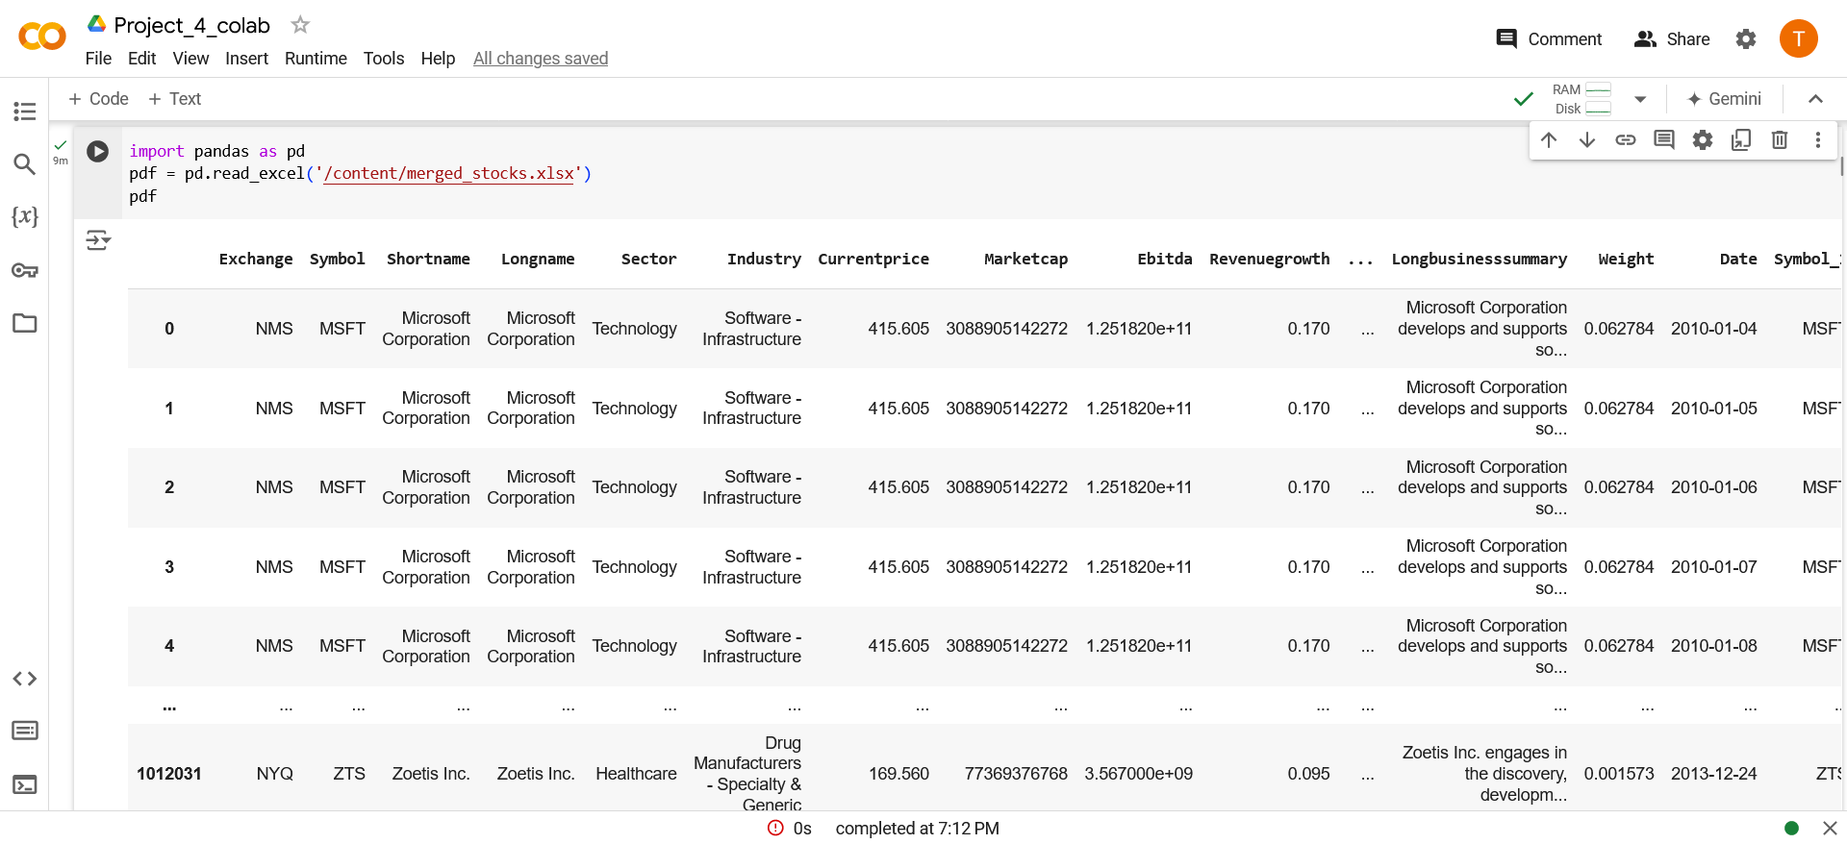
Our Initial Data

Slide 19
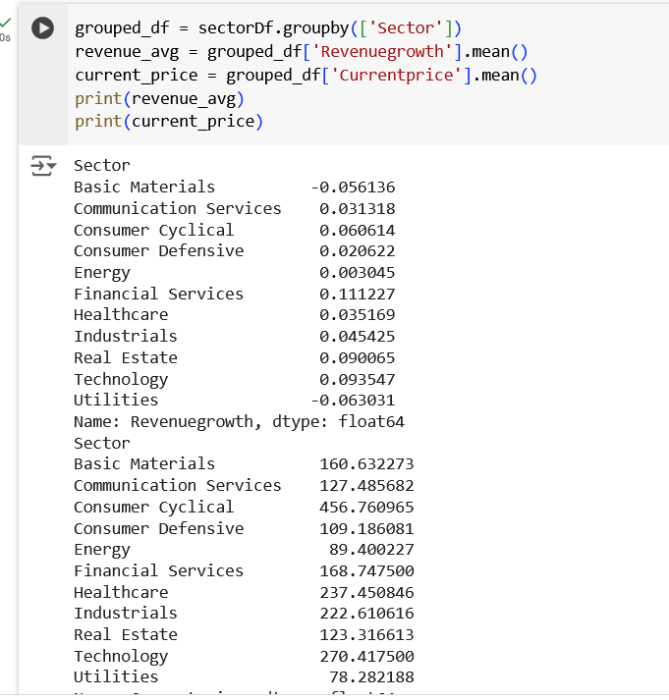
Growth by Sector
Revenue Growth & Average Price

Slide 20
Company vs. Avg. Growth

Slide 21
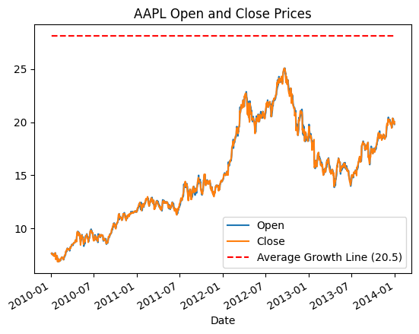
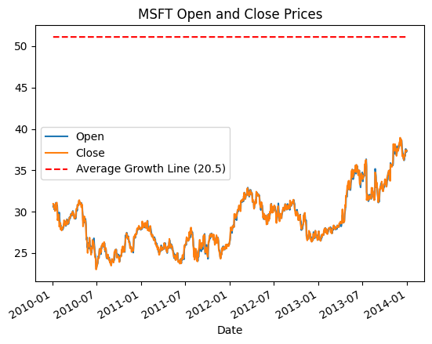

Slide 22
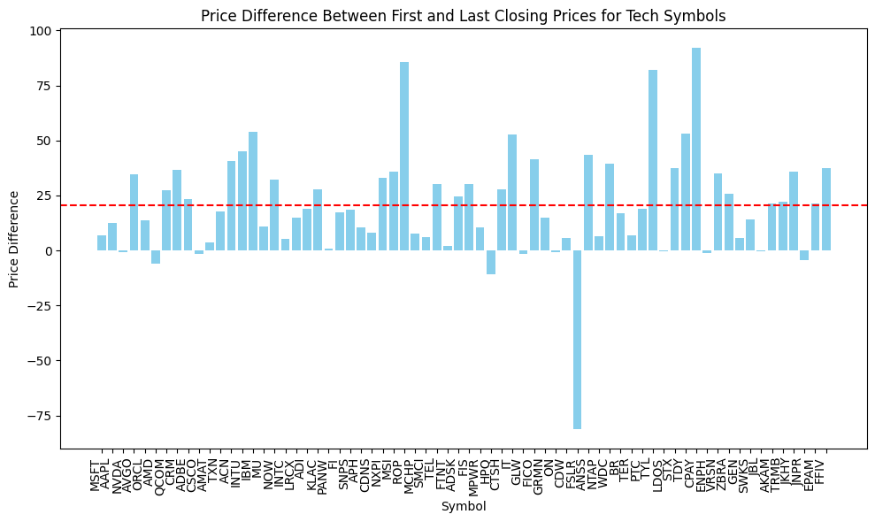

Slide 23
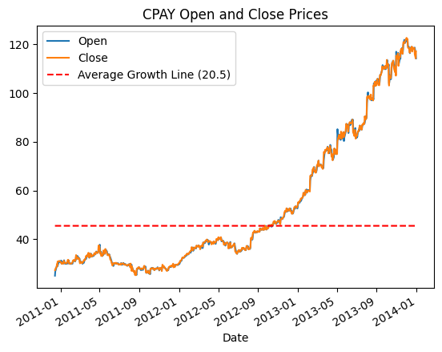
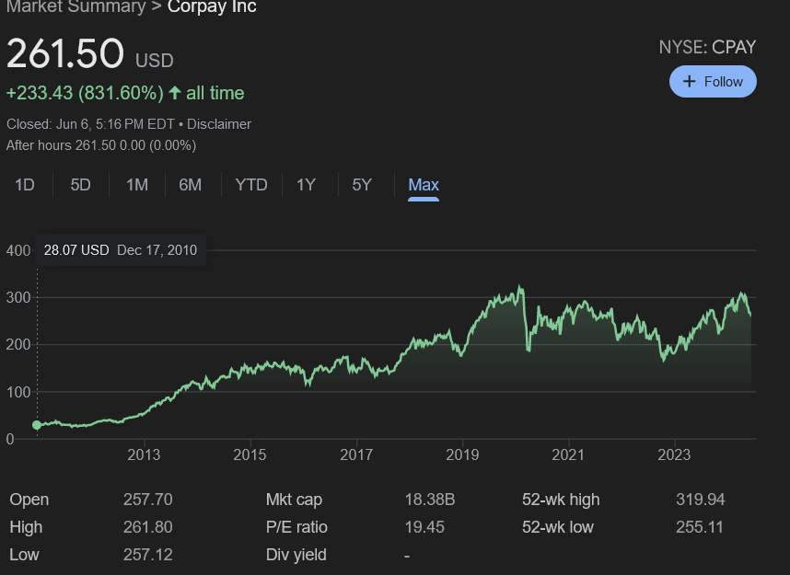

Slide 24
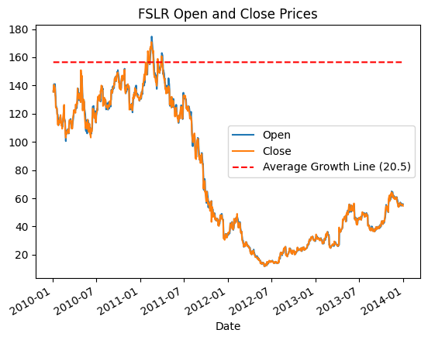
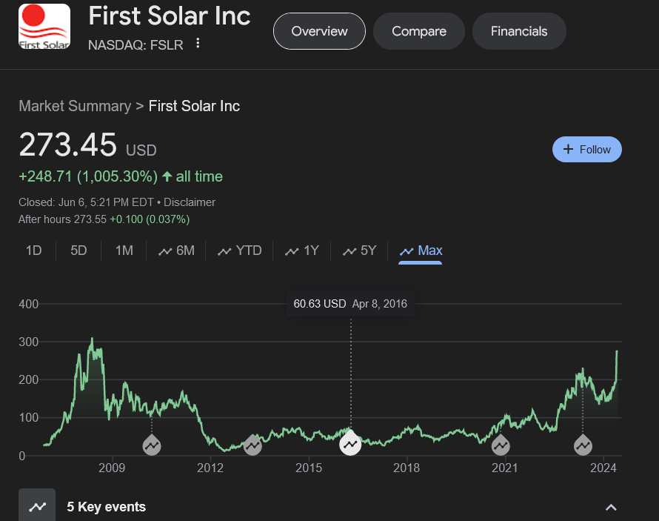

Slide 25
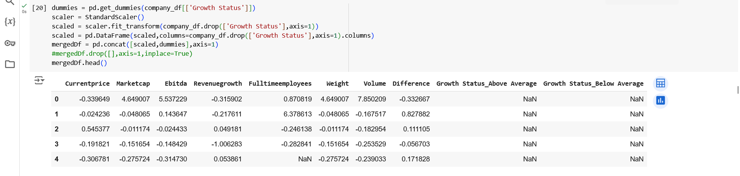
Data Cleaning & Preprocessing

Slide 26
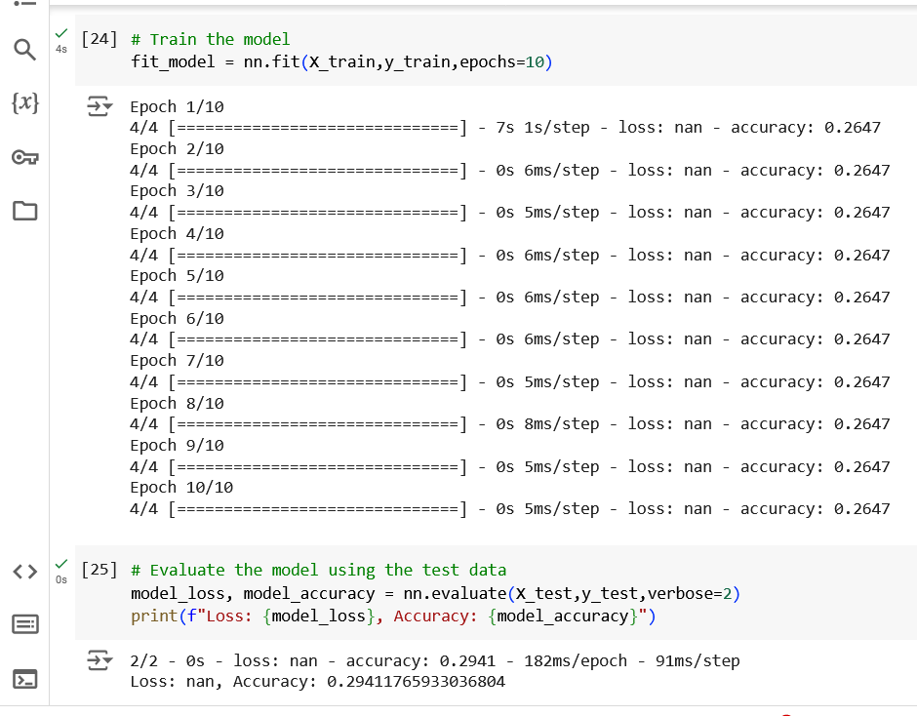
Initial Model - Looking at Company Data
Included Features:
Marketcap
EBITDA
Revenue Growth
Full Time Employees
Volume
27% Accuracy

Slide 27
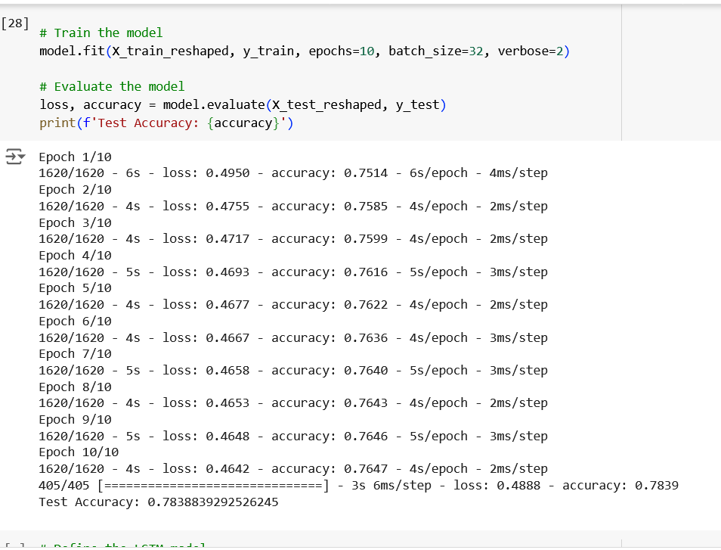
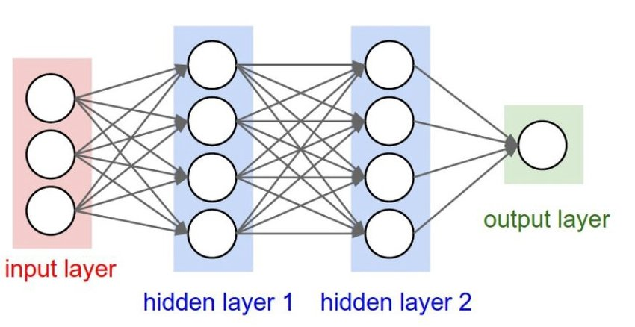

V2 - Looking at Open/Close Data -LSTM

Slide 28
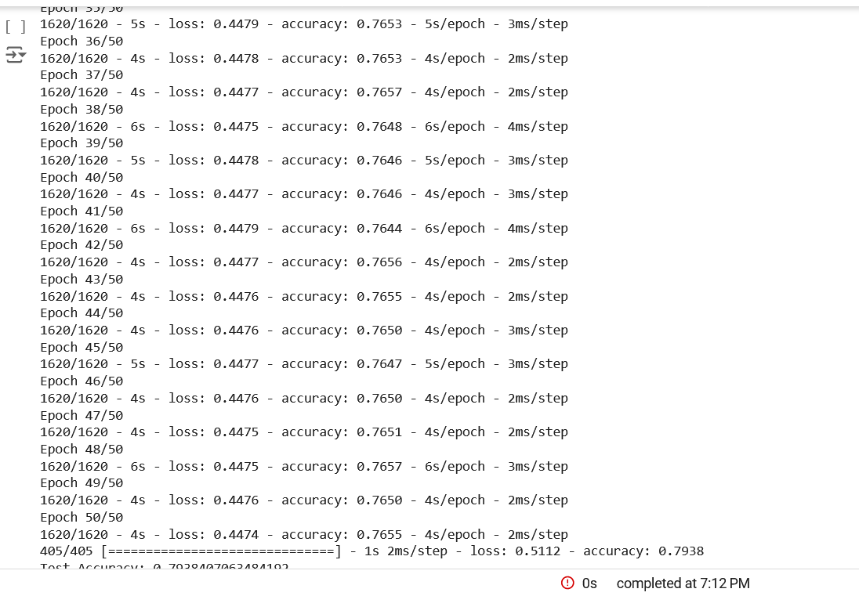
Optimized Model
Accuracy: 79.38%

Slide 29
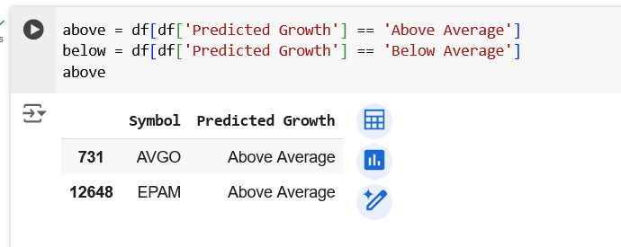

Slide 30
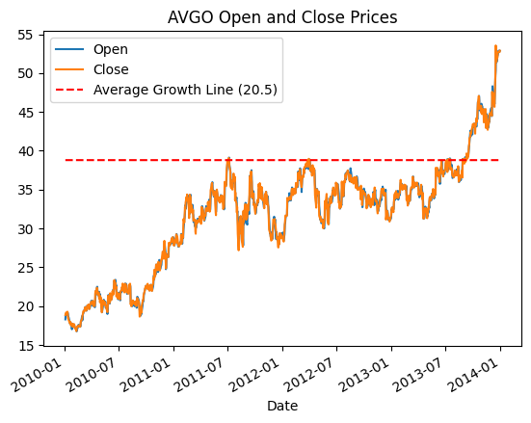
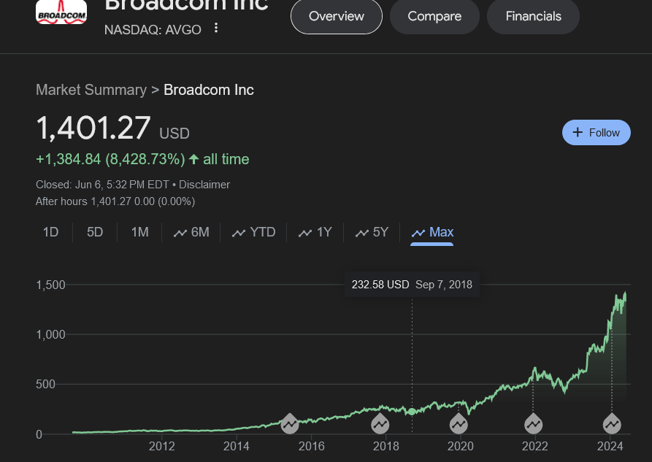

Slide 31
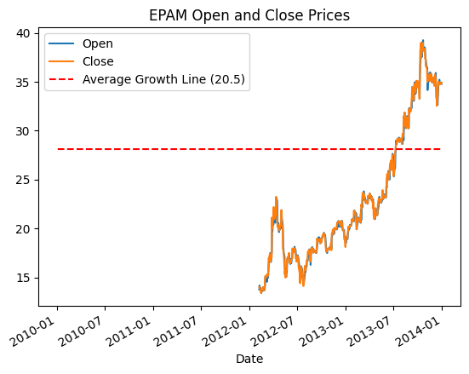
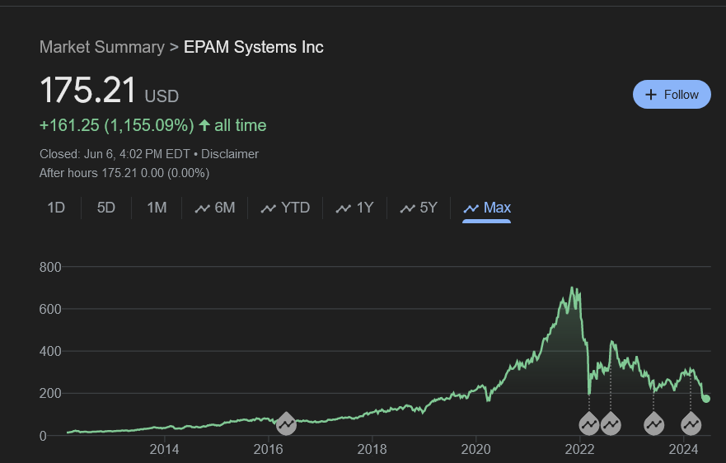

Slide 32

Double click: Electronic gaming and multimedia

Slide 33
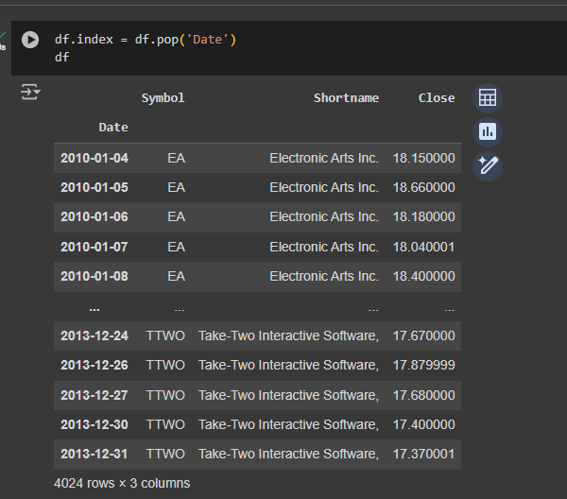
LSTM Model - Looking at Game Stocks
Notes:
What is LSTM?
The long short-term memory (LSTM) model is an advanced recurrent neural network (RNN) architecture used in the field of deep learning. It has feedback connections. It can process entire sequences of data. The LSTM machine learning model learns a function that maps a sequence of past observations as input to an output observation.

Slide 34
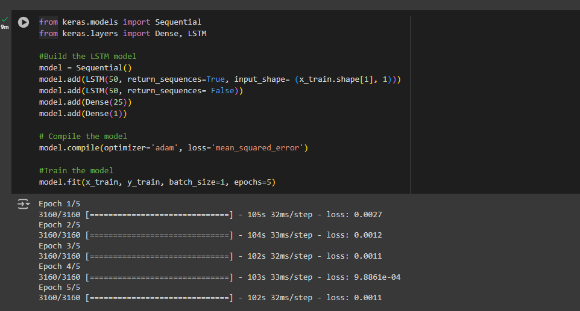
LSTM Model - Looking at Game Stocks

Slide 35
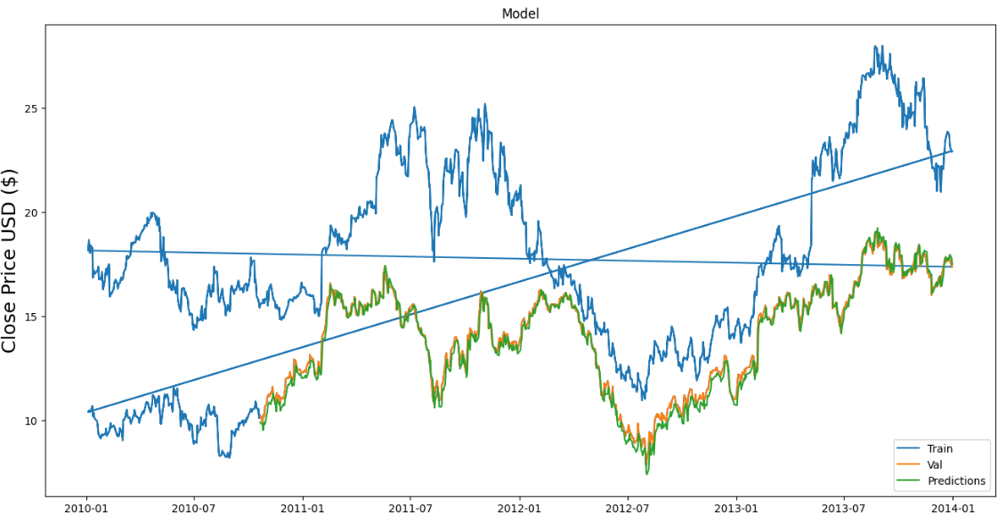
An RMSE of 0.38377 indicates that, on average, the difference between the predicted values and the actual values is about 0.38377 units. A RMSE of 0.38377 indicates a moderate level of error.
Accuracy: ~62%

Slide 36
Financial Data & Stock Exchange Industry
Revenue Growth as a Predictor of Stock Price using Decision Trees

Slide 37
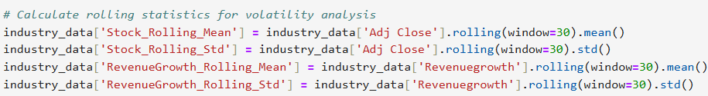
Decision Tree results
20% used for training, 80% used for training
100 decision trees
R^2 = .24 RMSE = .029
Using this decision tree model, revenue growth can only be used to explain 24% of the variance in stock price growth and volatility. The model only explains a small portion of variability in stock returns.

Slide 38
Conclusions
Our best model has an accuracy of 79% which is better than the market average for similar models.
AltIndex
Most accurate stock predictor for 2024; Uses alternative data (social media, website analytics)
AI converts data into risk-averse stock picks
72% win rate, 21% average 6-month gains
Danelfin
AI stock predictor covering NYSE, NASDAQ, and European markets
158% growth (2017-2022), compared to S&P 500's 70% growth
60% win rate for Buy signals (long) and a 60% loss rate for Sell signals (short)
Alpha Picks by Seeking Alpha
Operational since December 2009
25% average annualized returns from 'Strong Buy' recommendations
Notes:
Accurate stock market predictions depend on past data, but financial markets are always changing. Because of this, prediction models can have trouble when unexpected events occur, as they don't have similar past events to reference.

Slide 39
Wedone!
fin

